Slide 1


Presented by
Kunal Panwar
Yelavarthi Suchitra
Shivam Satish Battinwar
Poranki Mohan Sai

Slide 2
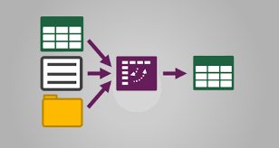
INTRODUCTION
Adventure Works Cycles is a large, multinational manufacturing company that produces and distributes metal and composite bicycles to commercial markets in North America, Europe, and Asia. The headquarters for Adventure Works Cycles is Bothell, Washington, where the company employees 500 workers. Additionally, Adventure Works Cycles employees several regional sales teams throughout its market base.
Creating a Relationship data model
Adding calculated fields with dax
Connecting and shaping data
Visualizing data with reports.

Slide 3
KPI’S AND INSIGHTS
KPI | Description | Example Insight
Total Sales | Total dollar value of products sold | "Sales peaked in Q4 due to holiday season."
Sales by Product Category | Breakdown of revenue per category (e.g., bikes, accessories) | "Mountain Bikes contribute 40% of total sales."
Sales by Region/Country | Compare performance by geography | "North America drives 70% of sales."

Slide 4
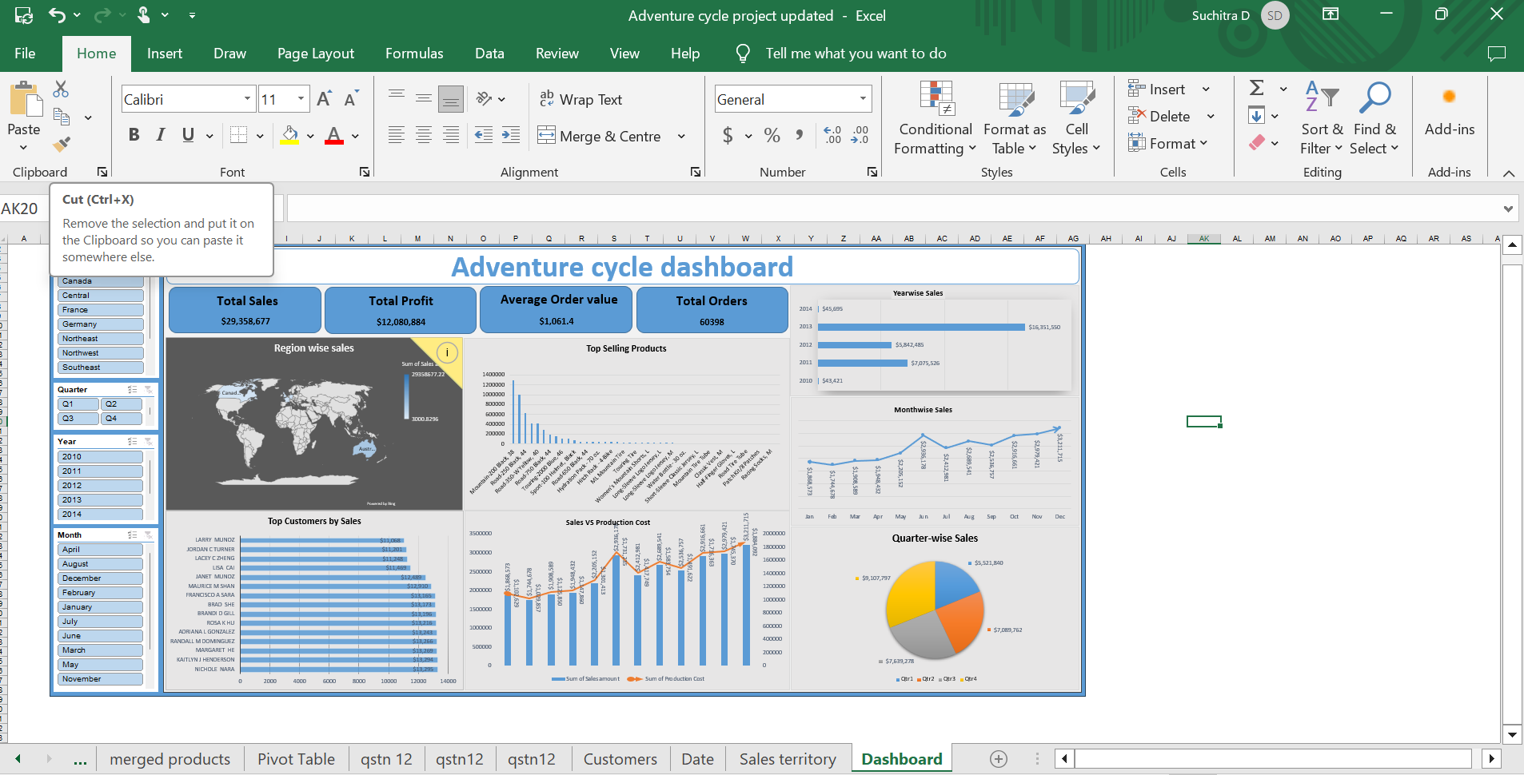
EXCEL DASHBOARD

Slide 5
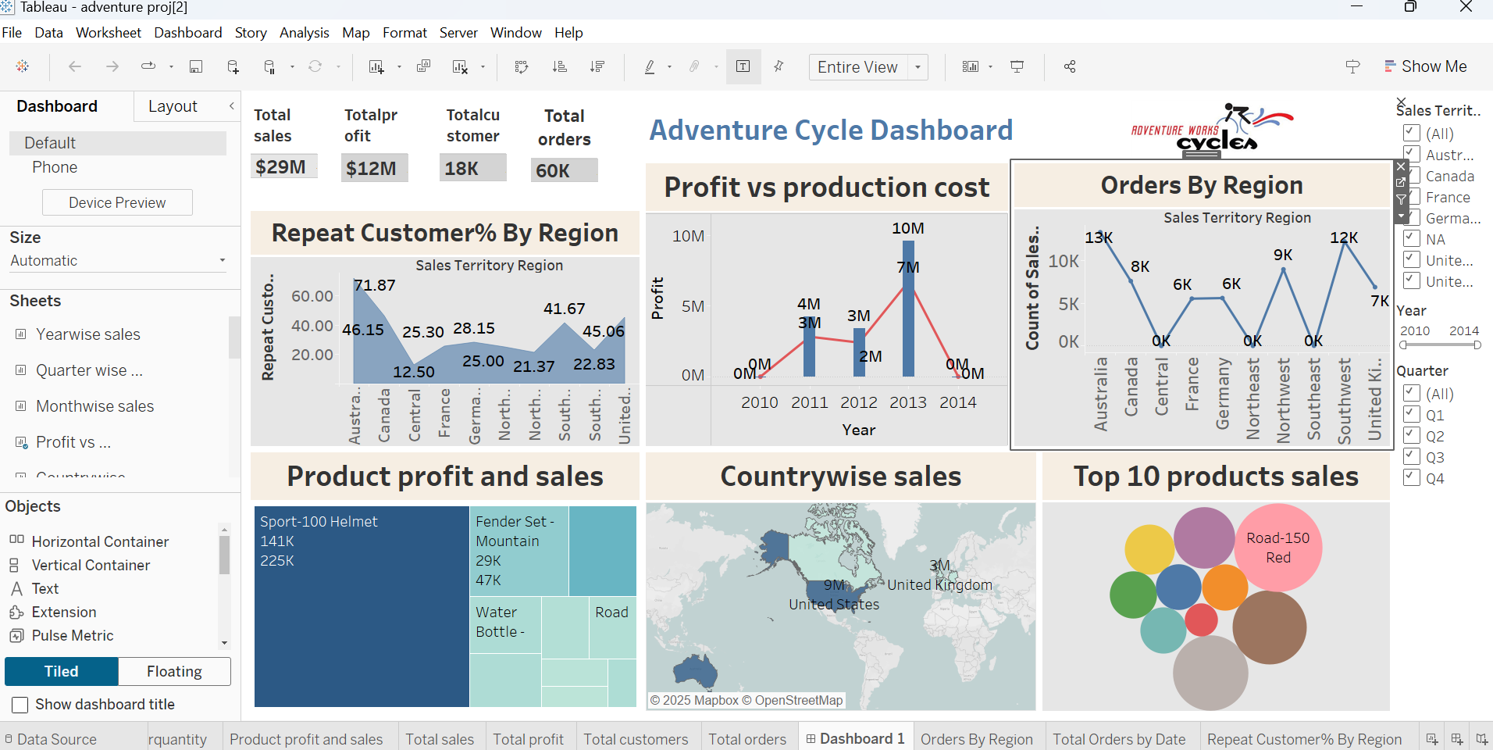
TABLEAU DASHBOARD

Slide 6
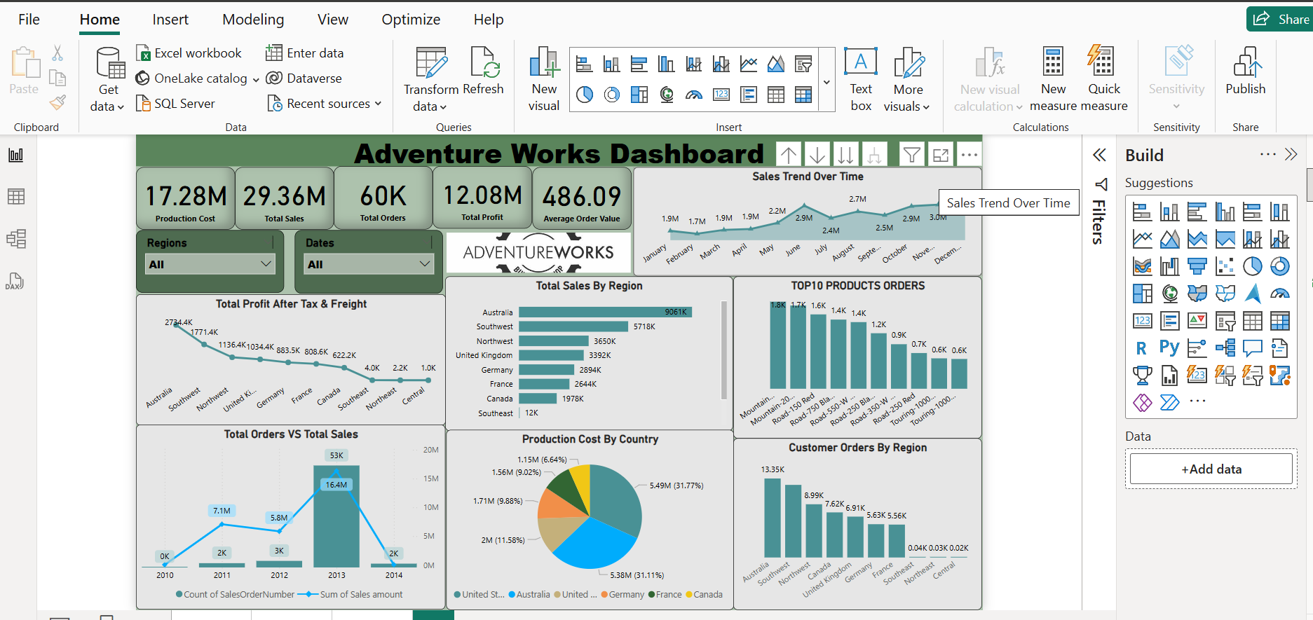
POWER BI DASHBOARD

Slide 7
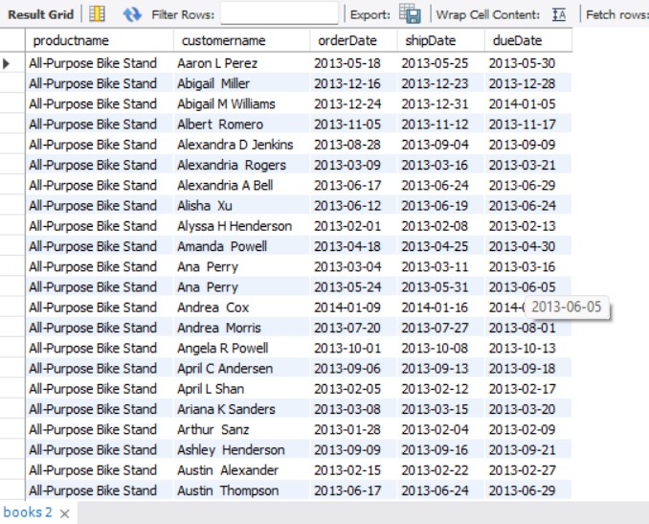
SQL QUERIES
Product wise customer wise orderdate,shipdate,duedate:
select
productname, customername,
orderDate,
shipDate,
dueDatefrom books
order by Productname,
Customername, OrderDate;

Slide 8
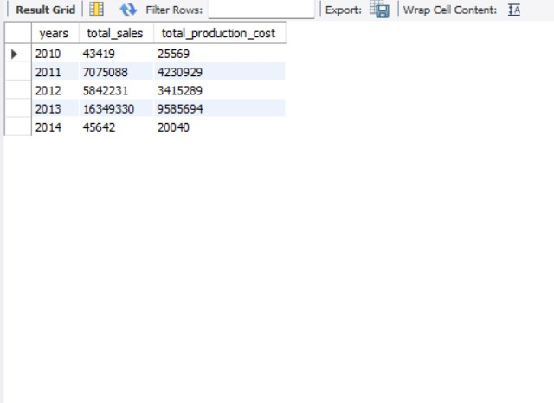
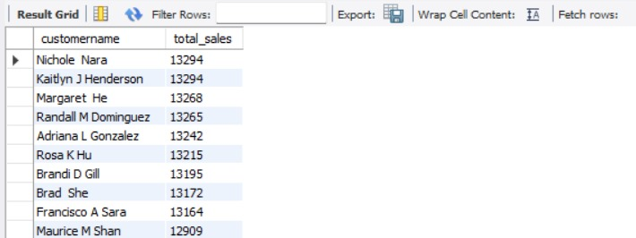
Year wise Total sales and Total production :
select years,
sum(sales) as total_sales,
sum(productioncost) as
total_production_cost from books
group by Years orders by years
Sales wise top 10 customers:
select customername,
sum(sales) as total_sales from books
group by Customername
order by Total_Sales
Desc limit 10;

Slide 9
Project SUMMARY
Conclusion
The Adventure Works project enabled us to develop deep into the company’s operations through a data-driven lens, highlighting several dimensions of performance and growth. By leveraging powerful analytical tools and techniques, we derived meaningful insights that reflect the company’s trajectory and areas of opportunity.
Key Learnings
1. Understanding Sales Trends and Market Performance:
By analyzing year-wise total sales and production costs.The data revealed how sales have progressed over time across regions, helping us evaluate market penetration and seasonal demand. This enabled a clear understanding of which years were most profitable and how production costs impacted overall margins.
2. Identifying High-Value Customers:
Through SQL queries and dashboards, we discovered the top 10 customers based on sales volume. This insight is vital for customer relationship management and strategic targeting. Knowing which customers contribute most to revenue.

Slide 10
3. Product Performance Analysis:
Detailed product-wise reports allowed us to assess which products were leading in terms of sales and delivery performance. By comparing different dates we evaluated supply chain efficiency and identified areas where delivery timelines could be improved.
4. Operational Efficiency:
Production cost analysis provided insight into the cost-effectiveness of manufacturing operations. By comparing sales and production figures, we could assess whether increased output was translating into increased profitability, offering a basis for optimizing production strategies.
5. Data-Driven Decision Making:
The integration of dashboards from Excel, Power BI, and Tableau allowed real-time visualization of KPIs and trends. This not only supported data interpretation but also empowered strategic decisions by providing an accessible overview of key business metrics.
6. Scalability and Market Strategy:
The regional sales data highlighted the company’s reach across North America, Europe, and Asia. Understanding geographic performance helps guide expansion strategies, reallocate resources, and tailor marketing approaches for different markets.

Slide 11
THANKYOU

